Slide 1
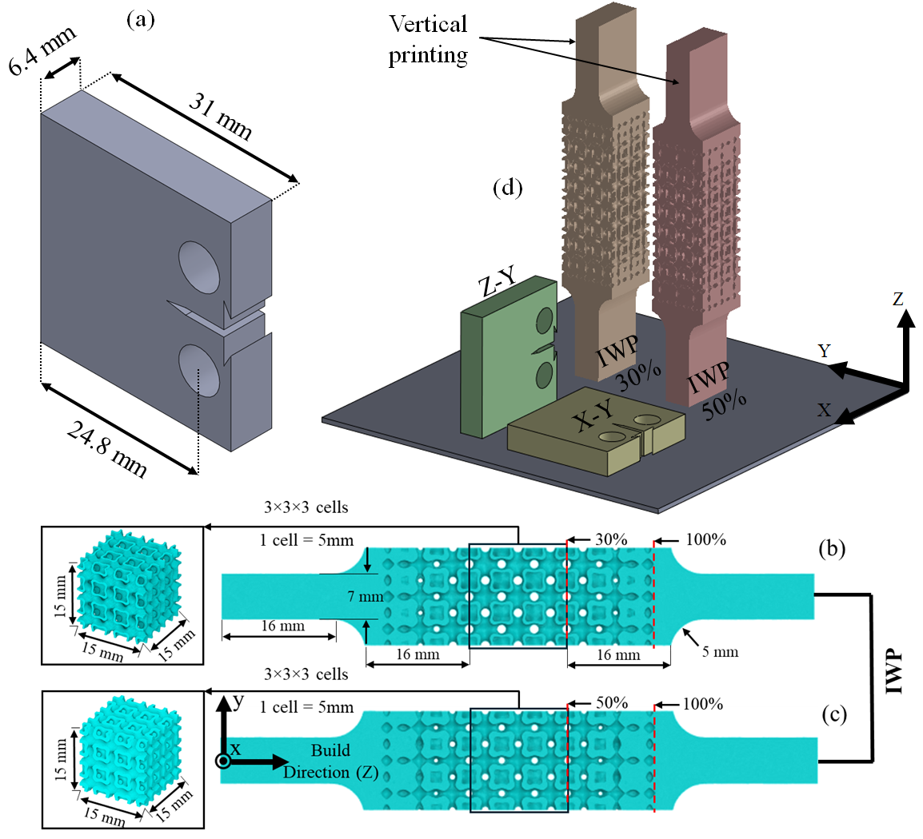
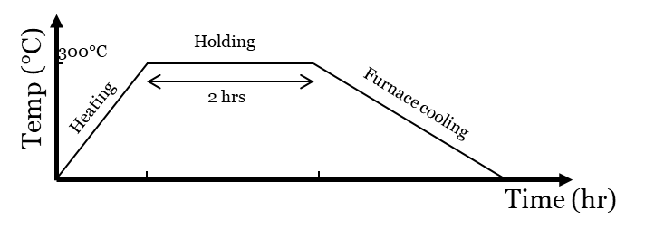
Mehodology: Specimen Design & Manufacturing
Geometry:
Compact Tension (CT) specimens
IWP-TPMS lattice dog-bone samples (from previous study)
Relative densities:
30% and 50%
Manufacturing:
Material: AlSi10Mg
Process parameters
Laser power: 370 W
Layer thickness: 30 µm
Scan speed: 1300 mm/s
Hatch spacing: 0.21 mm
Interlayer rotation strategy: 45° / –45°
For CT specimens
Four conditions:
2 printing direction (Z-Y & X-Y) ×
2 treatments (As-built & Stress-relieved)
1
Notes:
Starting with the specimen, two types of specimens were used:
compact tension specimens, designed according to ASTM E647 for crack growth characterization,
and IWP-dog-bone samples at 30% and 50% relative densities.
All specimens were fabricated using AlSi10Mg.
For the CT specimens, four conditions were considered by combining two build orientations, horizontal and vertical, with as-built and stress-relieved states.
The stress-relief heat treatment was applied at 300°C for two hours to reduce residual stresses.

Slide 2
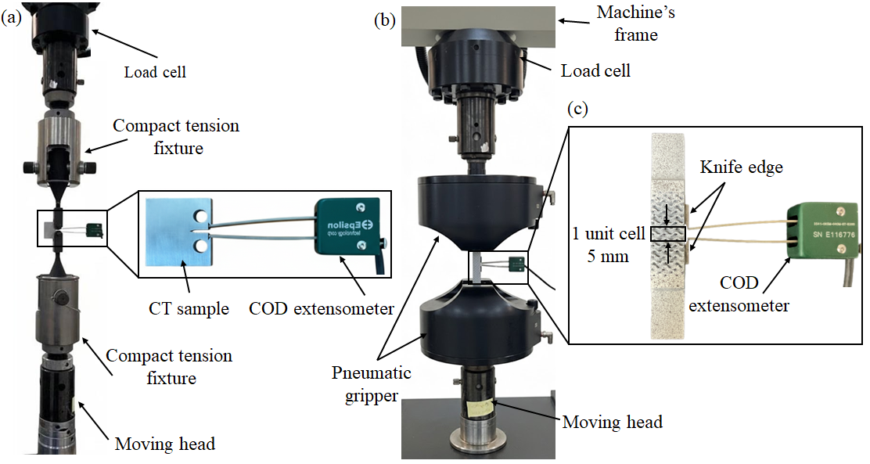



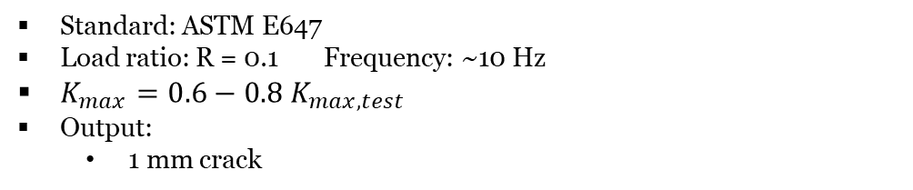

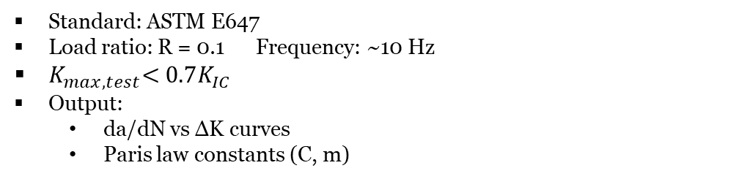


Stress
Mehodology: Mechanical Testing
Fatigue Pre-crack
Fatigue Crack Growth (FCG)
Quasi-static and Fatigue
Standard: ASTM E647
Load ratio: R = 0.1 Frequency: ~10 Hz
$K_{max}=0.6−0.8 K_{max,test}$
Output:
1 mm crack
Fatigue Crack Growth (FCG):
Standard: ASTM E647
Load ratio: R = 0.1 Frequency: ~10 Hz
$K_{max,test}\text{<}\text{ 0.7}K_{IC}$
Output:
da/dN vs ΔK curves
Paris law constants (C, m)
Quasi-static tests:
Determine effective yield strength ($σ_{y}$)
Fatigue testing for dogbone samples
Determine crack length and number of cycles to fail
$$R=0.1$$
$$σ_{max}$$
Frequency$=10 Hz$
$$Δσ$$
$$σ_{min}$$
2
Notes:
Moving to mechanical testing procedure.
First, fatigue pre-cracking was performed according to ASTM E647 to ensure consistent crack initiation conditions.
Then, fatigue crack growth tests were conducted under a load ratio of 0.1 and a frequency of around 10 Hz, with the maximum stress intensity kept below fracture toughness.
Quasi-static tests were used to determine the effective yield strength, which defines the fatigue loading levels.
Finally, fatigue tests on dog-bone specimens were performed to measure crack length and cycles to failure.

Slide 3
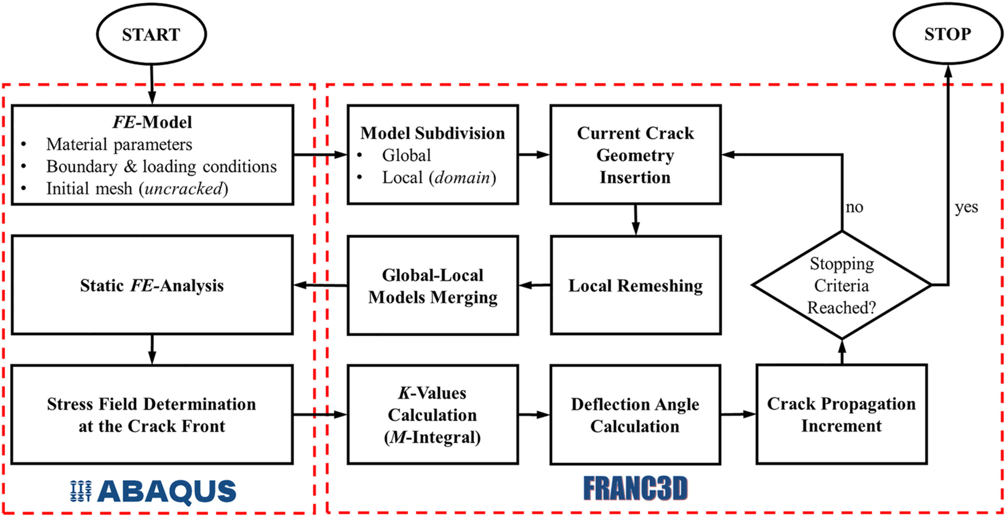

Mehodology: Fatigue Crack Simulation
3
Notes:
Moving to the fatigue crack growth simulation workflow, we start with the FE model, defining material properties, boundary conditions, the mesh, and the initial crack, followed by a static analysis to obtain the stress field at the crack front.
The model is then subdivided into global and local domains, where the crack is locally refined.
Stress intensity factors are computed using the M-integral, and the crack direction and growth increment are determined.
This process is repeated until the stopping criterion is reached, using ABAQUS or ANSYS for stress analysis and FRANC3D for crack propagation.

